Slide 1
Liabilities

Slide 2
Capital Structure
Companies finance operations from two sources:
Equity – owners, shareholders
Liabilities - lenders, vendors and customers
The mix of debt and equity is the company’s capital structure.

Slide 3
Liabilities – overview
Liabilities - probable future sacrifice of economic benefits that arise from past transactions.
Types by maturity: Current (short-term) and Long-term
Types by source: Operating and Financial (non-operating)

Slide 4
Operating liabilities – Starbucks example
Purchase coffee inventory
Customers pay in advance
Employees earn wages
Rent store space for coffeehouse
Accounts payable
Deferred revenue (stored value card liability”)
Accrued wages (accr. liabilities)
Accrued rent (accr. liabilities)
Source: Financial accounting, Libby, Libby and Hodge, 10th edition, McGraw-Hill Education

Slide 5
Financial liabilities
Financial liabilities (debt) represents capital provided by financial partners. The contractual cost is called interest.
Short term debt – needs to be repaid within one year. Long term debt – could be obtained in a private transaction or via issuance of publicly traded securities (commercial paper, bonds).
Each type of financing has pros and cons.

Slide 6
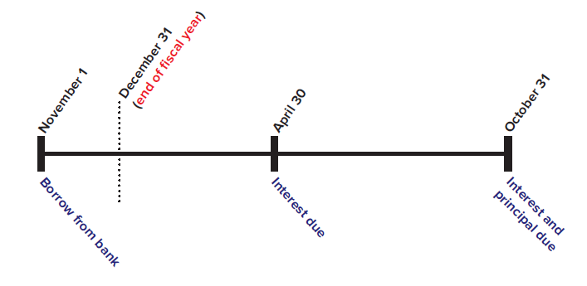
Note/Loan Payable and interest expense
A note payable: formal written contract that specifies the principal, the repayment date and the interest rate.
Source: Financial accounting, Libby, Libby and Hodge, 10th edition, McGraw-Hill Education

Slide 7
Note/Loan Payable and interest – reporting
At the time of borrowing: Cash and liabilities increase by the same amount. No effect on the income statement.
At the end of each reporting period: the interest is reported as an expense on the income statement even if not paid in cash.
At the loan due date: Cash and the liabilities decrease by the amount repaid. No effect on the income statement.

Slide 8
What drives the interest rate?
The interest rate for financial liabilities is affected by:
Nominal base rate – risk free rate including inflation
Premium for maturity – compensation for time horizon
Premium for default risk – varies with credit quality
  The credit quality depends on: Business risk and Financial risk.

Slide 9
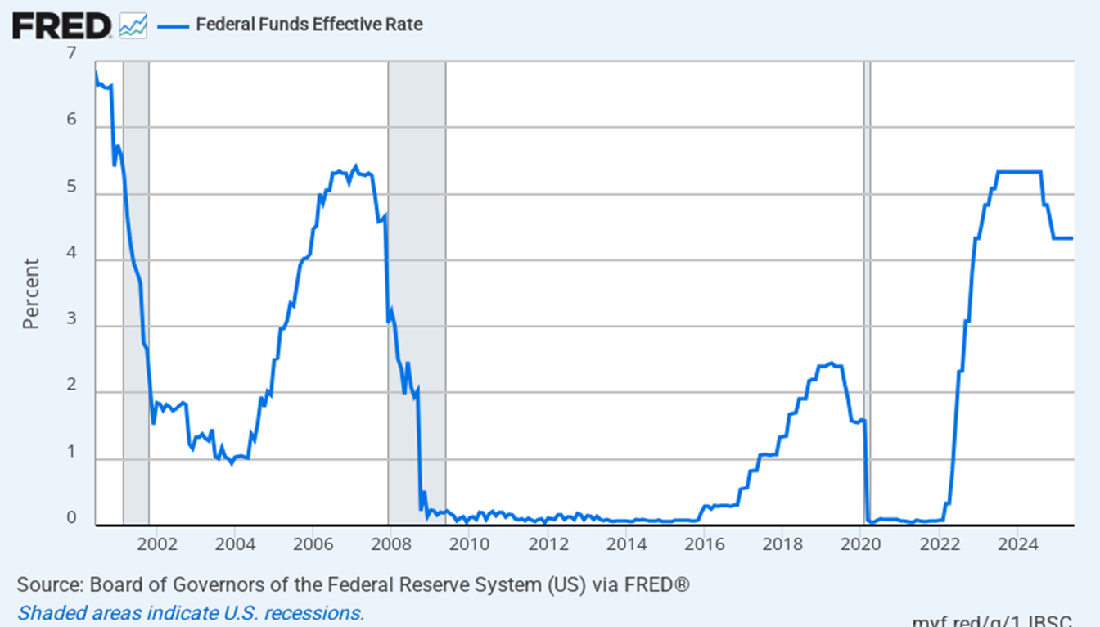
Historical Fed Funds rate
Source: Board of Governors of the Federal Reserve System (US) –June 2025

Slide 10
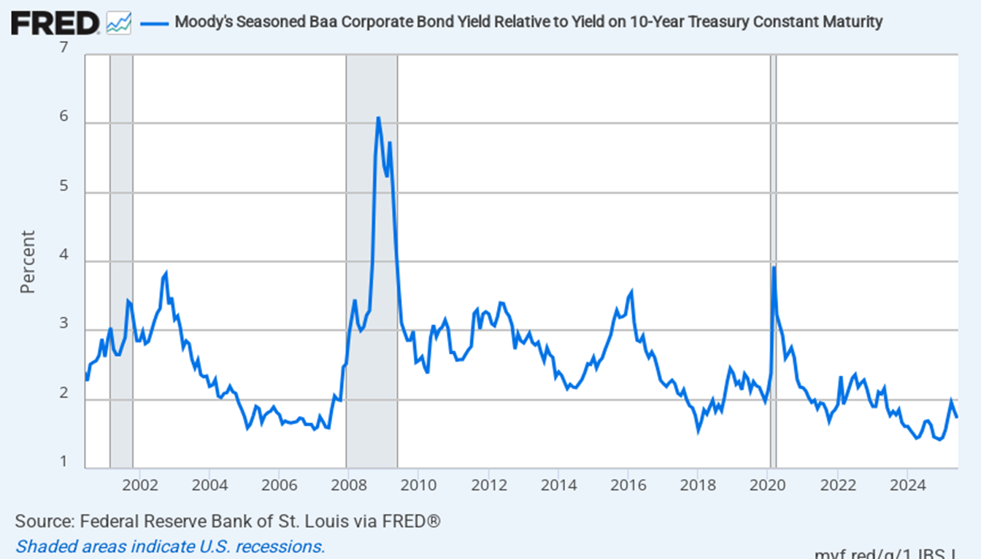
Historical credit spreads (Baa – US Treasury)
Source: Board of Governors of the Federal Reserve System (US) – June 2025

Slide 11
Indebtedness – metrics
Debt / Assets and Debt / Equity:
show what % of the assets is financed with debt.
Interest coverage: EBIT / interest expense:
shows the company’s ability to service its debt.
The ratios have effect on the company’s credit rating and therefore, the cost of its debt capital.

